Slide 1
Doc Intelligence Platform
Sanjeev Patra | TWT AI Powered Doc Mastery | sanjeevpatra-777/Sanjeev

Slide 2
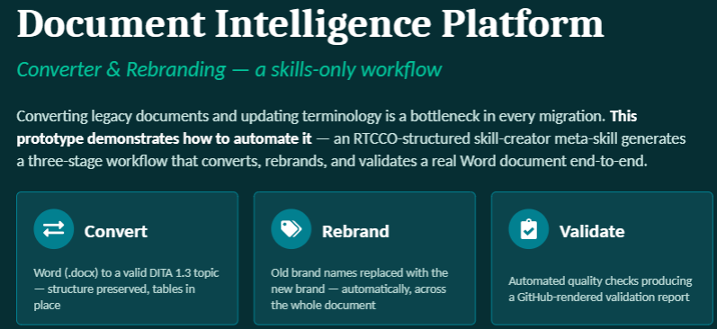
Project Introduction

Slide 3
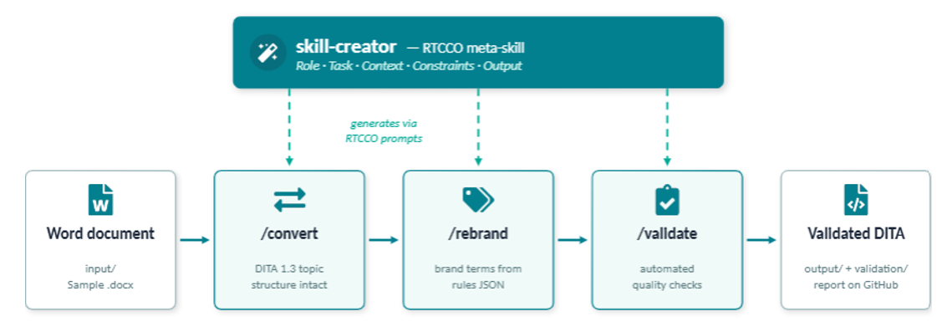
High-Level Approach

Slide 4
Skill-creator
/skill-creator
R — Role:
You are a Senior DITA Information Architect with 15 years of experience in structured authoring, XML content engineering, and enterprise
documentation migration. You specialise in converting unstructured Word documents into valid, well-formed DITA 1.3 topics while
preserving complete document fidelity.
T — Task:
Create a skill named "convert" that converts a Microsoft Word (.docx) document into a single valid DITA 1.3 topic file. The skill takes the
input filename (without path) as $ARGUMENTS, reads the document from the input/ folder, and writes the converted DITA file to the output/ folder.
C — Context:
The input documents are software setup guides and system design documents produced by technical writers. A representative sample
(input/Sample_Doc_for_DITA_Conversion.docx) contains:
a document title, two levels of headings, introduction paragraphs, bullet lists, a numbered procedure section titled "Procedure: Creating a New Project",
two data tables (an entity/attributes table and a stakeholder table), two figure references with captions ("Figure 1" and "Figure 2"),
bold inline formatting, and a milestones list.
The converted DITA output will be consumed by a downstream rebranding skill and then a validation skill, so structural correctness matters more than visual styling.

Slide 5
Skill-creator
C — Constraints:
- MUST produce a single DITA 1.3 <topic> document with a DOCTYPE declaration (<!DOCTYPE topic PUBLIC "-//OASIS//DTD DITA Topic//EN“ "topic.dtd">).
- MUST make <title> the first child of <topic>, using the document’s main heading.
- MUST give the root <topic> an id attribute derived from the filename (lowercase, hyphens for spaces).
- MUST map Word heading levels to nested <section> elements with <title> children; do not flatten the hierarchy.
- MUST convert bullet lists to <ul>/<li> and numbered lists to <ol>/<li>.
- MUST render the procedure section as an <ol> of steps inside its own <section>.
- MUST convert Word tables to DITA <table>/<tgroup>/<thead>/<tbody> markup with correct column counts, preserving header rows.
- MUST keep every element in its ORIGINAL document order — tables and figures must appear exactly where they appear in the Word document, not collected at the end. This is a known failure mode; treat it as the highest-priority correctness rule.
- MUST represent figures as <fig> with <title> from the caption and an <image href="images/<figure-name>.png"/> placeholder.
- MUST preserve bold inline formatting as <b> and italic as <i>.
- MUST NOT invent, summarise, reorder, or omit any content — this is a lossless structural conversion, not a rewrite.
- MUST NOT use any Python scripts or external tools; perform the conversion by reading the document and writing the XML directly.
- MUST report a conversion summary at the end: counts of sections, paragraphs, lists, tables, and figures converted.

Slide 6
Skill-creator
O — Output:
- Output file: output/$ARGUMENTS-output.dita (where $ARGUMENTS is the input filename without its .docx extension — e.g. input/Sample_Doc_for_DITA_Conversion.docx becomes output/Sample_Doc_for_DITA_Conversion-output.dita)
- Encoding: UTF-8, XML declaration on line 1, DOCTYPE on line 2.
- Console summary: table of element counts plus the output file path.
- Example invocation: /Sample_Doc_for_DITA_Conversion_Converted.docx

Slide 7
RTCCO framework

